Slide 1

Unit – 2
Array, String & Collection Classes
FOET
Department of AI
Java Programming

Slide 2
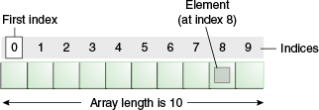
Group oflike-typed variables
Referred by a common name
Arrays

Slide 3
Advantages ofArray
We can store multiple elements of the same type under a single variable.
We can implement other datastructures such as Stack, Queue, Tree, etc. with the help of an array.
We can fetch data elements using the index at run time.
Array
Disadvantages ofArray
Before using an array, it is mandatory to declare its size.
It is a static structure, so we can not increase or decreases memory allocation.
Insertion and deletion operations are difficult because elements stored at the contiguous memory location. It also increases the cost.
Allocate more memory than required is the wastage of memory.

Slide 4

int month_days[ ];
type var-name[];
// OR
type[ ] var name;
int[ ] month_days;
array-var = new type[size];
One- Dimensional Arrays
Example:
month_days = new int[12];
int month_days[] = { 31, 28, 31, 30, 31, 30, 31, 31, 30, 31,30, 31 };
This is called compile-time initialization OR static initialization of array.

Slide 5
1. int array1[]={5,10,15,20,25};
2. Int array1[] =new int[5];
for(j=0;j<5;j++)
array1[j] =j+5;
Initialization of Array
3. intarray1[] =new int[5]; array1[0]=5; array1[1]=10; array1[2]=15; array1[3]=20; array1[4]=25;

Slide 6
class Testarray{
public static void main(String args[]){
int a[] = new int[5];//declaration and instantiation
a[0]=10;//initialization a[1]=20;
a[2]=70;
a[3]=40;
a[4]=50;
//traversing array
for(int i=0;i<a.length;i++)//length is the property of array
System.out.println(a[i]);
}
}
Example

Slide 7
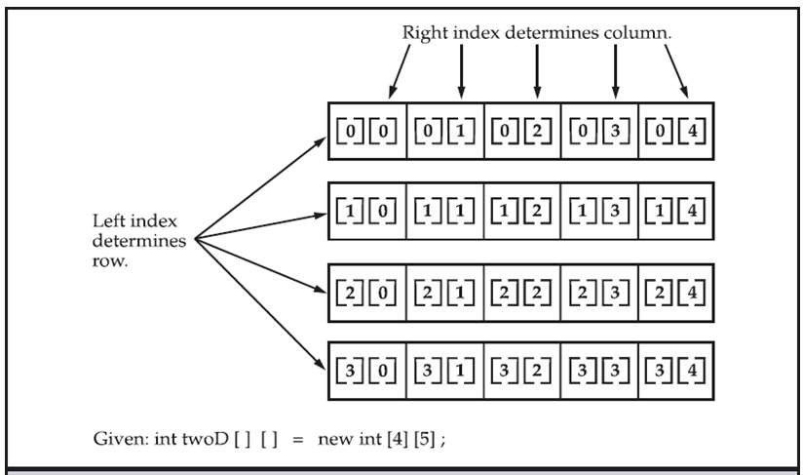
int twoD[][] = new int[4][5]
Multi- dimensional Arrays
Conceptual View of a 4 by 5 two dimensional array

Slide 8



Data in a table or a matrix can be represented using a two dimensional array.
An element in atwo-dimensional arrayis accessed through arow
and columnindex.
Syntax:
elementType[ ][ ] arrayRefVar;
OR
elementType arrayRefVar[ ][];
Ex:
int[ ][ ] matrix;
OR
int matrix[ ][ ];
Two- Dimensional Array

Slide 9
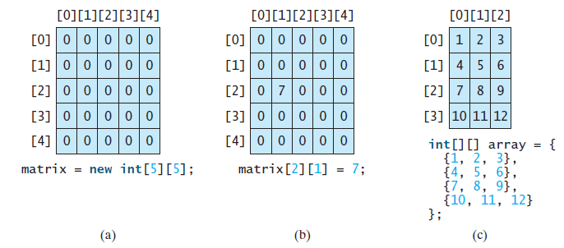
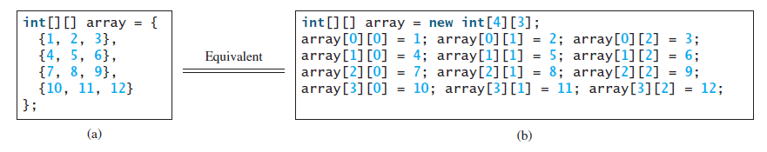
Two- Dimensional Array

Slide 10
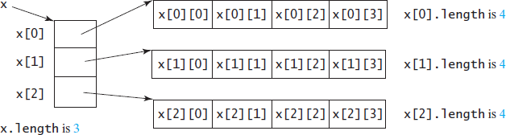
x = new int[3][4], x[0], x[1], and x[2] are one-dimensional arrays and each contains four elements. So, x.length is 3, and x[0].length, x[1].length, and x[2].length are 4.
Ex:
Obtaining length of2-D Array

Slide 11
class MultidimensionalArray {
public static void main(String[] args) {
// create a 2d array int[][] a = {
{1, 2, 3},
{4, 5, 6, 9},
{7},
};
// calculate the length of each row System.out.println("Length of row 1: " + a[0].length); System.out.println("Length of row 2: " + a[1].length); System.out.println("Length of row 3: " + a[2].length);
}
}
OUTPUT
Length of row 1: 3
Length of row 2: 4
Length of row 3: 1

Slide 12
String is basically an object that represents sequence of char values. An array of characters works same as Java string.
char[] ch={'j','a','v','a','p',‘r',‘o',‘g',‘r‘,’a’,’m’};
String s=new String(ch);
String
is same as
String s="javaprogram";
Java String class provides a lot of methods to perform operations on strings such as compare(), concat(), equals(), split(), length(), replace(), compareTo(), intern(), substring() etc.

Slide 13
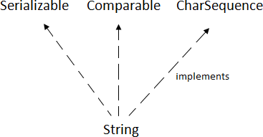
java.lang.String class provides a lot of methods to work on a string.
The java.lang.String class
implements Serializable, Comparable and CharSequence interfaces.
String Class

Slide 14
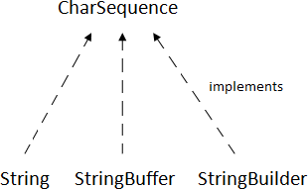
String, StringBuffer and StringBuilder classes implement it. It means, we can create strings in Java by using these three classes.
The CharSequence interface is used to represent the sequence of characters.
CharSequence Interface
Note: String Builder class is not in the syllabus of this course.

Slide 15
Once a String object is created it cannot be changed. Strings are Immutable.
To get changeable strings use the class called StringBuffer.
String anyString=null;
Array of String:
Stringnames[ ] =newString[5];
Initialization of array of String:
String Class
String names[ ]= {“Red”, “Orange”, “Yellow”, “Green”, “Blue”, “Indigo”,“Violet”};

Slide 16
There are two ways to create String object:
By string literal
By new keyword
1. Java String literal is created by using double quotes. For Example: String s="welcome";
How to create a string object?
Each time you create a string literal, the JVM checks the "string constant pool" first. If the string already exists in the pool, a reference to the pooled instance is returned. If the string doesn't exist in the pool, a new string instance is created and placed in the pool. For example:
String s1="Welcome";
String s2="Welcome";//It doesn't create a new instance

Slide 17
Why Java uses the concept of String literal?
How to create a string object?
To make Java more memory efficient (because no new objects are created if it exists already in the string constant pool).

Slide 18
2. By new keyword
String s=new String("Welcome");
How to create a string object?
In such case, JVM will create a new string object in normal (non- pool) heap memory, and the literal "Welcome" will be placed in the string constant pool. The variable s will refer to the object in a heap (non-pool).

Slide 19
public class StringExample{
public static void main(String args[]){
String s1="java";//creating string by Java string literal
char ch[]={'s','t','r','i','n','g','s'};
String s2=new String(ch);//converting char array to string
String s3=new String("example");//creating Java string by new key
How to create a string object?
word System.out.println(s1); System.out.println(s2); System.out.println(s3);
}}
Output Java strings example

Slide 20
1. DefaultConstructor:
String str =new String( );
String Class Constructors
String object using an array of Characters
  String(char charArray[ ])
  char Name[ ] ={‘J’, ‘A’, ‘V’, ‘A’, ‘P’, ‘R’, ‘O’, ‘G’};
  StringstrName =newString(Name);

Slide 21

3. String Object Initialized by range from chararray
String(char charArray[ ],intstartindex, int no_of_char)
startIndex : starting index is inclusive
endIndex : ending index is exclusive
char Name[ ] ={‘J’, ‘A’, ‘V’, ‘A’, ‘P’, ‘R’, ‘O’, ‘G’};
StringstrName =newString(Name, 3, 5); // APR
String Class Constructors
String object using another String Object:
  String (StringstrObject);
  char Name[ ] ={‘J’, ‘A’, ‘V’, ‘A’, ‘P’, ‘R’, ‘O’, ‘G’};
  StringstrName =newString(Name);
StringstrName2 =newString(strName);

Slide 22
String Literals:
char Name[ ] ={‘J’, ‘A’, ‘V’, ‘A’, ‘P’, ‘R’, ‘O’, ‘G’};
StringstrName =newString(Name);
OR
String strName= “JAVAPROG”;
String Class

Slide 23
The length()method returns the length of the string.
Ex:System.out.println(“Hello”.length());// prints 5
String Operations
The +operator is used to concatenate two or more strings.
Eg: String myname =“Harry”;
String str =“My nameis” +myname+ “.”;
For string concatenation the Java compiler converts an operand to a String when ever the other operand of the +is a String object.

Slide 24
Characters in a string can be extracted in a number of ways.
public char charAt(int index)
String Operations
Returns the character at the specified index. An index ranges from 0 to length() - 1. The first character of the sequence is at index 0, the next at index 1,and so on, as for arrayindexing.
charch;
ch =“abc”.charAt(1); // ch =“b”

Slide 25
destination character rarray.
getChars() - Copies characters from this string into the
publicvoid getChars(int srcBegin, int srcEnd, char[] dst, int dstBegin)
srcBegin – index of the first character in the stringto copy.
srcEnd - index after the last character in the stringto copy.
dst- the destination array.
dstBegin- the start offset in the destination array.
String Operations

Slide 26

Example
public class StringGetCharsExample{
public static void main(String args[]){
String str = new String("hello Marwadi how r u");
char[] ch = new char[10]; try{
str.getChars(6, 15, ch, 0);
System.out.println(ch);
}catch(Exception ex){System.out.println(ex);}
}}
Output
Marwadi how r

Slide 27
equals() – Compares the invoking string to the specified object.
The result is true if and only if the argument is not null and is a String object that represents the same sequence of characters as the invoking object.
String Operations
public boolean equals(ObjectanObject)
equalsIgnoreCase()- Compares this String to another String, ignoring case considerations. Two strings are considered equal ignoring case if they are of the same length, and corresponding characters in the two strings are equal ignoring case.
public boolean equals IgnoreCase(String anotherString)

Slide 28
startsWith()– Tests if this string starts with the specified prefix.
Public Boolean startsWith(Stringprefix) “Figure”.startsWith(“Fig”); //true
endsWith() - Testsif this string ends with the specified suffix.
String Operations
public boolean endsWith(String suffix)
“Figure”.endsWith(“re”); //true
String str1= “JAVA”;
String str2= “JAVA PROGRAMMING”;
String str3=“MING”; str2.startWith(str1); str2.endsWith(str3);

Slide 29
startsWith() –Tests if this string starts with the specified Prefix beginning at as pecified index.
Public boolean startsWith(Stringprefix, int toffset)
prefix- the prefix.
toffset - whereto begin looking in the string.
String Operations
“figure”.startsWith(“gure”, 2); // true

Slide 30
compareTo() - Compares two strings lexico graphically. The result is a negative integer if this String object lexico graphically precedes the argument string.
The result is a positive integer if this String object lexico graphically follows the argument string.
String Operations
The result is zero if the strings are equal.
compareTo returns 0 exactly when the equals(Object) method would
Return true.
public int compareTo(String anotherString) public int compareToIgnoreCase(Stringstr)

Slide 31
indexOf– Searches for the first occurrence of a character or substring. Returns-1if the character does not occur.
Public int indexOf(intch)- Returns the index within this string of the first occurrence of the specifiedcharacter.
String Operations
Public int indexOf(Stringstr)- Returns the index within this string of the first occurrence of the specified substring.
String str =“How was your day today?”; str.indexof(‘t’);
str.indexof(“was”);

Slide 32
public int indexOf(int ch, int fromIndex)- Returns the index within this string of the first occurrence of the specified character, starting the search at the specified index.
Public int indexOf(String str, int fromIndex)- Returns the index within this string of the first occurrence of the specified substring, starting at the specified index.
String Operations
Stringstr =“How wasyour daytoday?”; str.indexof(‘a’,6);
str.indexof(“was”,2);
lastIndexOf() –Searches for the last occurrence of a character or substring.

Slide 33
public class IndexOfExample{
public static void main(String args[]){ String s1="this is index of example";
//passing substring
int index1=s1.indexOf("is");//returns the index of is substring
int index2=s1.indexOf("index");//returns the index of index substring System.out.println(index1+" "+index2);//
String Operations
//passing substring with from index
int index3=s1.indexOf("is",4);//returns the index of is substring after 4th index System.out.println(index3);//i.e. the index of another is
//passing char value
int index4=s1.indexOf('s');//returns the index of s char value System.out.println(index4);
}
}

Slide 34
public String substring(int beginIndex)
substring() - Returns a new string that is a substring of this string. The substring begins with the character at the specified index and extends to the end of this string.
String Operations
Eg:"unhappy".substring(2) returns"happy"
Public String substring(int beginIndex,int endIndex)
Eg:"smiles".substring(1, 5) returns“mile”

Slide 35
concat()- Concatenates the specified stringto the end of thisstring.
If the length of the argument tstring is 0, then this String object is
returned.
String Operations
Otherwise, a new String object is created, containing the invoking string with the contents of the str appended to it.
public String concat(String str) "to".concat("get").concat("her") returns"together"

Slide 36
replace()-Returns a new string resulting from replacing all Occurrences of old Char in this string with newChar.
public String replace(char oldChar, char newChar) "mesquite in yourcellar".replace('e','o') returns"mosquito in yourcollar"
String Operations
trim()- Returns a copy of the string, with leading and trailing White space omitted.
public String trim()
String s=“ Hi Mom! “.trim();
returns “HiMom!”

Slide 37
Summary
No. | Method | Description
1 | char charAt(int index) | returns char value for the particular index
2 | int length() | returns string length
3 | String substring(int beginIndex) | returns substring for given begin index.
4 | String substring(int beginIndex, int endIndex) | returns substring for given begin index and end index.
5 | boolean contains(CharSequences) | returns true or false after matching the sequence of char value.
6 | static String join(CharSequence delimiter, CharSequence... elements) | returns a joined string.
7 | boolean equals(Object another) | checks the equality of string with the given object.
8 | boolean isEmpty() | checks if string is empty.
9 | String concat(String str) | concatenates the specified string.
10 | static String equalsIgnoreCase(String another) | compares another string. It doesn't check case.
11 | String[] split(String regex) | returns a split string matching regex.
12 | int indexOf(int ch) | returns the specified char value index.
13 | int indexOf(String substring) | returns the specified substring index.
14 | String toLowerCase() | returns a string in lowercase.
15 | String toUpperCase() | returns a string in uppercase.

Slide 38
Random method :This method generates a random double value greater than or equal to 0.0 and less than 1.0 (0 <= Math.random()<1.0)
Math.random()
Ex.(int)(Math.random() * 10)- - >Returns a random Integer between 0 and 9.
a+Math.random()* b- - >Returns a random number between a and a+b, excluding a+b.
Ex. 50+(int)(Math.random() * 100) - - >Returns a Random integer between 50 and 99.

Slide 39
A StringBuffer is like a String, but can be modified.
StringBuffer is a peer class of String that provides much of the functionality of strings. String represents fixed-length, immutable character sequences while StringBuffer represents growable and writable character sequences.
The length and content of the StringBuffer sequence can be changed through certain method calls.
String Buffer
StringBuffer defines three constructors:
StringBuffer()
StringBuffer(int size)
StringBuffer(Stringstr)

Slide 40
The principal operations on a StringBuffer are the append and insert methods, which are overloaded so also accept data of any type.
Here are few append methods: StringBuffer append(String str) StringBuffer append(int num)
StringBuffer
The append method always adds these characters at the end of the buffer.

Slide 41
The insert method adds the characters at a specified point.
Here are few insert methods: StringBufferinsert(int index, String str)
String Buffer insert(int index, char ch)
StringBuffer
Index specifies at which point the string will be inserted into the invoking String Buffer object.

Slide 42
delete() – Removes the characters in a substring of this StringBuffer.
The substring begins at the specified start and extends to the character at index end – 1 or to the end of the StringBuffer if no such character exists. If start is equal to end, no changes are made.
public StringBuffer delete(int start, int end)
reverse()-The character sequence contained in this string buffer is replaced by the reverse of the sequence.
public StringBuffer reverse()
length()- Returns the length of this stringbuffer.
public int length()
StringBuffer

Slide 43
replace()- Replaces the characters in a substring of this StringBuffer with characters in the specified String. public StringBuffer replace(int start, int end, Stringstr) substring() - Returns a new String that contains a sub sequence of characters currently contained in this StringBuffer.
The substring begins at the specified index and extends to the end of the StringBuffer.
Public String substring(int start)
StringBuffer

Slide 44
capacity()- Returns the current capacity of the Stringbuffer. The capacity is the amount of storage available for newly inserted characters.
public int capacity()
StringBuffer
charAt()- The specified character of the sequencecurrently represented by the string buffer, as indicated by the index argument, is returned.
public char charAt(int index)

Slide 45
Public void getChars(int srcBegin, int srcEnd, char[] dst, int dstBegin)
getChars() - Characters are copied from this string buffer into the destination character array dst. The first character to be copied is at index srcBegin; the last character to be copied is at index srcEnd-1.
StringBuffer
setLength() – Sets the length of the StringBuffer.
Public void setLength(int newLength)

Slide 46
 | No. | Method | Description
 | 1 | length() | The length of a StringBuffer can be found by the length( ) method
 | 2 | capacity() | the total allocated capacity can be found by the capacity( ) method.
 | 3 | append() | It is used to add text at the end of the existence text
 | 4 | insert() | It is used to insert text at the specified index position.
Summary | 5 | reverse() | It can reverse the characters within a StringBuffer object
 | 6 | delete(int startIndex, int endIndex) | It can delete characters within a StringBuffer by using the methods delete( )
 | 7 | replace() | It can replace one set of characters with another set
 | 8 | indexOf(String str) | This method returns the index within this string of the first occurrence of the specified substring.
 | 9 | lastIndexOf(String str) | This method returns the index within this string of the last occurrence of the specified substring.
 | 10 | substring(int start) | This method returns a new String that contains a subsequence of characters

Slide 47
public class buffer {
public static void main(String[] args)
{
StringBuffer a = new StringBuffer(“stringbuffer”);
a.append(“in Java”); System.out.println(a); a.append(0); System.out.println(a);
}
}

Slide 48
import java.io.*;
public class buffer {
public static void main(String[] args)
{
StringBuffer a = new StringBuffer(“stringbuffer”);
a.insert(5, “for”); System.out.println(a); a.insert(0, 5); System.out.println(a); a.insert(3, false); System.out.println(a); a.insert(5, 41.55d); System.out.println(a); a.insert(8, 41.55f); System.out.println(a); char arr[] = { ‘j’, ‘a’, ‘v’, ‘a’ }; a.insert(2, arr); System.out.println(a);
}
}

Slide 49
import java.io.*; public class buffer {
public static void main(String[] args)
{
StringBuffer a = new StringBuffer(“stringbuffer”);
a.replace(5, 8, “are”); System.out.println(a);
}
}
output
strinareffer

Slide 50
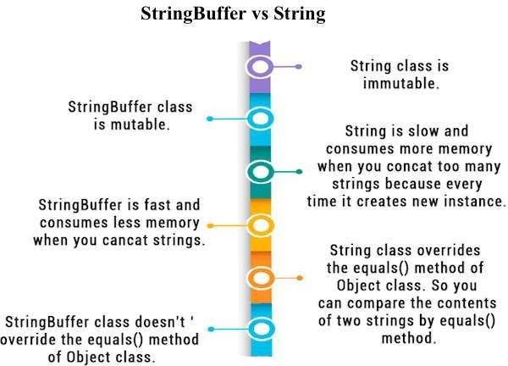
String Vs.
StringBuffer

Slide 51
The wrapper class in Java provides the mechanism to convert primitive into object and object into primitive.
Since J2SE 5.0, auto boxing and unboxing feature convert primitives into objects and objects into primitives automatically. The automatic conversion of primitive into an object is known as autoboxing and vice-versa unboxing.
Wrapper class

Slide 52
Change the value in Method: Java supports only call by value. So, if we pass a primitive value, it will not change the original value. But, if we convert the primitive value in an object, it will change the original value.
Serialization: We need to convert the objects into streams to perform the serialization. If we have a primitive value, we can convert it in objects through the wrapper classes.
Synchronization: Java synchronization works with objects in
Multithreading.
Use of Wrapper class
java.util package: The java.util package provides the utility classes to deal with objects.
Collection Framework: Java collection framework works with objects only. All classes of the collection framework (ArrayList, LinkedList, Vector, HashSet, LinkedHashSet, TreeSet, PriorityQueue, ArrayDeque, etc.) deal with objects only.

Slide 53
Each wrapper class implements methods specific to each data type except void class.
Common methods implemented in all wrapper class:
  Class Type(type)
  type typeValue()
  int hashCode()
  String to String()
  boolean equals(Objectobj)
  static booleanvalueOf(Strings)
Wrapper Class

Slide 54
Wrapper Class
Primitive Data Type | Wrapper Class | Constructor Argument
boolean | Boolean | boolean or String
byte | Byte | byte or String
char | Character | char
int | Integer | int or String
float | Float | float, double or String
double | Double | double or String
long | Long | long or String
short | Short | short or String

Slide 55
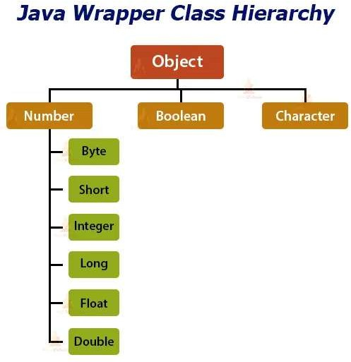
Wrapper Class

Slide 56
Ex.Character c1=newCharacter(‘x’);
1. ClassType(type):
typeValue( ):
Ex. char c2 =c1.typeValue();
toString( ):
Ex. System.out.println(c1.toString());
equals():
Ex.S1.equals(s2);
valueOf( ):
Ex. Byte b1=valueOf(“101”,2);
Common Methods in WrapperClass

Slide 57
BooleanClass:
static boolean getBoolean(Stringname)
Boolean, Byte, Short Class
ByteClass:
static byte parseByte(String s,int radix)
staticbyte parseByte(String s)
ShortClass:
shortValue()

Slide 58
static booleanisLowerCase(char ch)
isLowerCase() & isUpperCase()
staticboolean isUpperCase(char ch) Ex.Character c=newCharacter(‘g’);
boolean isLower=Character.isLowerCase(c);
isDigit( )
static boolean isDigit(charch)
Ex. boolean isDigit=Character.isDigit(‘7’);
isSpace()
static boolean isSpace(charch)
Ex. boolean isSpace =Character.isSpace(‘\t’);
Character class

Slide 59

toLowerCase( ) & toUpperCase() static char toLowerCase(char ch)
static char toUpperCase(char ch)
Ex. char c1 = Character.toUpperCase(‘g’);
char c2 =Character.toLowerCase(‘M’);
Character
class
digit( )
static int digit(char ch, int radix)
Ex. char c1 =‘4’; char c2 =‘c’;
int four =Character.digit(c1,10); int twelve =Character.digit(c2,16);
forDigit( )
static char forDigit(int digit, int radix)
int i=10;
char c =Character.forDigit(I,16);

Slide 60
Integer & Long Class
parseInt( )
static int parseInt(String s, int radix)
static int parseInt(String s)
Ex. Integer i = new Integer(17); float f = i.floatValue();
Integer &
LongClass
getInteger( )
static Integer getInteger(String name)
static Integer getInteger(String name, int val) static Integer getInteger(String name, Integer val)

Slide 61
Float & Double Class:
isNaN( )
boolean isNaN()
static boolean isNaN(floatv)
Ex. Double d1 = newDouble(23.70); System.out.println(“is d1 is not a number?” +d1.isNaN());
isInfinite( )
boolean isInfinite()
static boolean isInfinite(floatv)
VoidClass:
void class has no constructors or methods & only one member constantTYPE.
Float &
DoubleClass

Slide 62
The automatic conversion of primitive datatype into its corresponding wrapper class is known as autoboxing.
For example, byte to Byte, char to Character, int to Integer, long to Long, float to Float, Boolean to Boolean, double to Double, and short to Short.
Since Java5, we do not need to use the valueOf() method of wrapper classes to convert the primitive into objects.
Autoboxing
public class WrapperExample1
{
public static void main(Stringargs[])
{
int a=20;
Integeri=Integer.valueOf(a); //converting int into Integerexplicitly
Integerj=a;
//autoboxing, nowcompiler will write Integer.valueOf(a) internally
System.out.println(a+" "+i+""+j);
}
}

Slide 63
The automatic conversion of wrapper type into its corresponding primitive type is known as unboxing. It is the reverse process of autoboxing.
Since Java5,we do not need to use the intValue() method of wrapper classes to convert the wrapper type into primitives.
Unboxing
public classWrapperExample2
{
publicstatic voidmain(String args[])
{
Integer a=newInteger(3); int i=a.intValue();
//converting Integerto int explicitly
int j=a;
//unboxing, nowcompiler will write a.intValue() internally System.out.println(a+" "+i+""+j);
}
}

Slide 64
2. Make the instance of the class Random
1. Import the class java.util.Random
Random class
i.e., Randomr =new Random();
3. Invoke one of the following methods of r object: nextInt(upperbound) generates random numbers in the range 0 toupperbound-1.
nextFloat() generates a float between 0.0and 1.0.
nextDouble() generates a double between 0.0 and 1.0.

Slide 65
import java.util.Random;
classGenerateRandom
{
publicstatic voidmain( Stringargs[])
{
Randomrand=new Random(); //instanceof random class
Random class Example
int upperbound= 25; //generate random values from0-24 int int_random = rand.nextInt(upperbound);
double double_random=rand.nextDouble();
float float_random=rand.nextFloat();
System.out.println("Random integer value from 0 to" + (upperbound-1) +" : "+ int_random);
System.out.println("Random float value between 0.0 and 1.0: "+float_random); System.out.println("Random double value between 0.0 and 1.0: "+double_random);
}
}

Slide 66
The java command-line argument is an argument i.e. passed at the time of running the java program.
The arguments passed from the console can be received in the java program and it can be used as an input.
Command Line Argument
So, it provides a convenient way to check the behavior of the program for the different values. You can pass N (1,2,3 and so on) numbers of arguments from the command prompt.
Check Program: commandLineArg.java

Slide 67
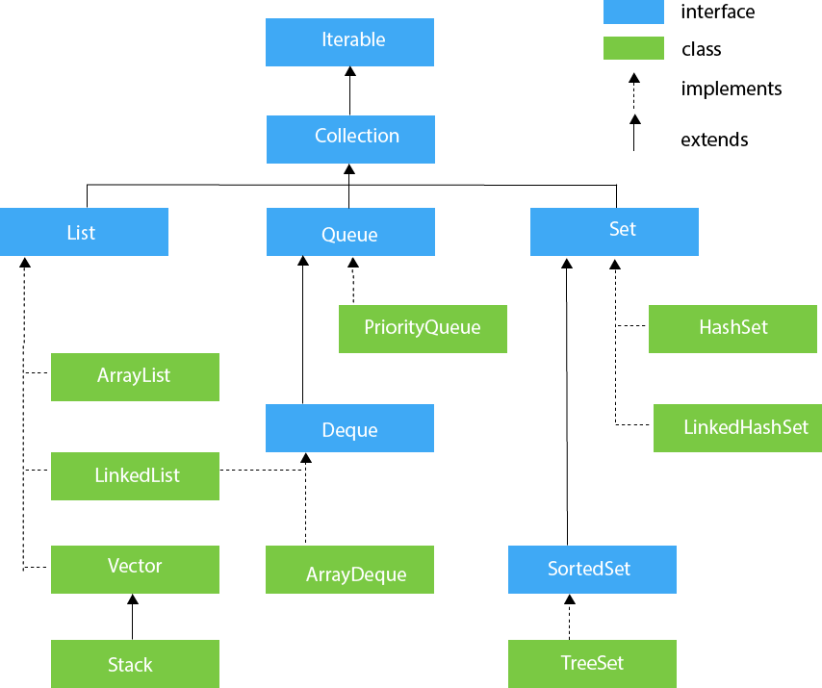
Collection Classes in Java

Slide 68
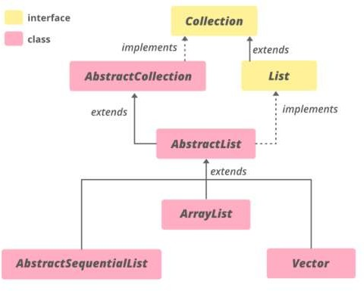
The AbstractList class in Java is a part of the Java Collection Framework and
implements the Collection interface and the Abstract Collection class.
Abstract List class
This class provides a skeletal implementation of the List interface to minimize the effort required to implement this interface backed by a Random Access data store (such as an array). For sequential access data (such as a linked list), Abstract Sequential List should be used in preference to this class.

Slide 69
To implement an unmodifiable list, for which one needs to only extend this AbstractList Class and implement the get(int) and the size() methods.
To implement a modifiable list, for which one additionally override the set(int index, E element) method (which otherwise throws an UnsupportedOperationException).
Abstract List class methods
If the list is variable-size, for which one should override the add(int, E) and remove(int) methods.

Slide 70
Declaration:
public abstract class implements List<E>
AbstractList<E>
extends
AbstractCollection<E>
where E is the type of elements maintained by this collection.
Constructor:
protected AbstractList() – The default constructor, but being protected, it doesn’t allow to create an AbstractList object.
Abstract List class
AbstractList<E> al = new ArrayList<E>();
Check example: AbstractListDemo.java

Slide 71
store the duplicate element of different data types.
The ArrayList class implements the List interface. It uses a dynamic array to
The ArrayList class maintains the insertion order and is non-synchronized.
The elements stored in the ArrayList class can be randomly accessed.
Java ArrayList class uses a dynamic array for storing the elements. It is like an array, but there is no size limit. We can add or remove elements anytime. So, it is much more flexible than the traditional array. It is found in the java.util package. It is like the Vector in C++.
Array List
The ArrayList in Java can have the duplicate elements also. It implements the List interface so we can use all the methods of the List interface here. The ArrayList maintains the insertion order internally.
It inherits the AbstractList class and implements List interface.
ArrayList<int> al = ArrayList<int>(); // does not work ArrayList<Integer> al = new ArrayList<Integer>(); // works fine
Check Program: ArrayListDemo.java

Slide 72
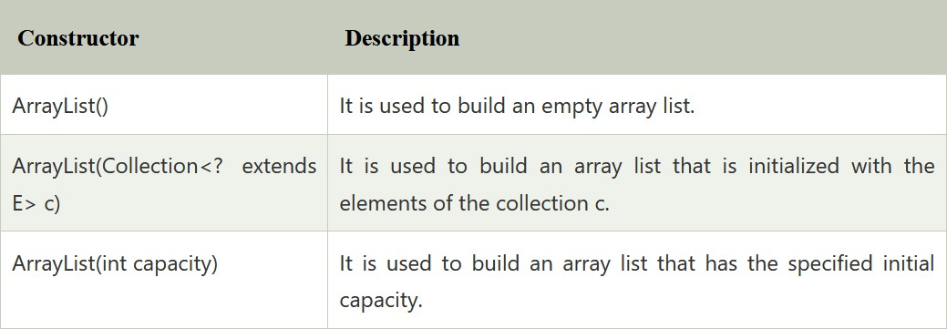
Array List
ArrayList Constructors :

Slide 73
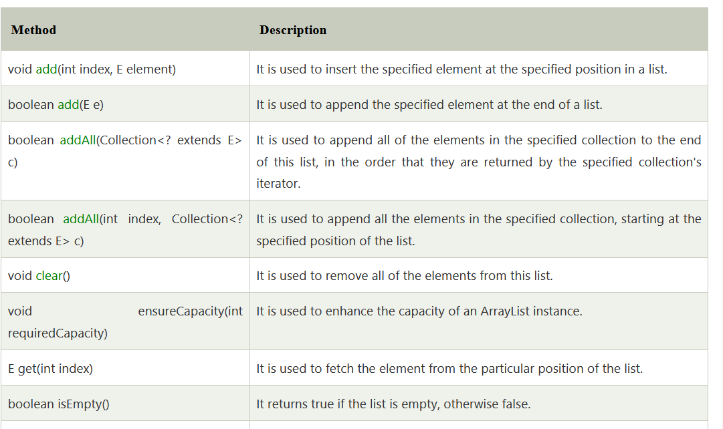
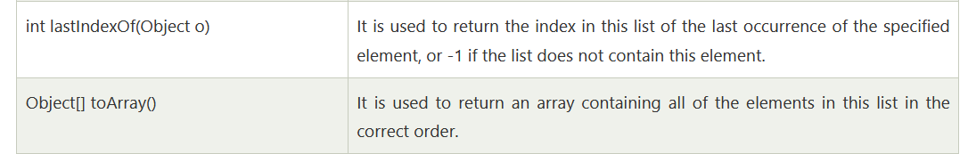
Array List Methods

Slide 74
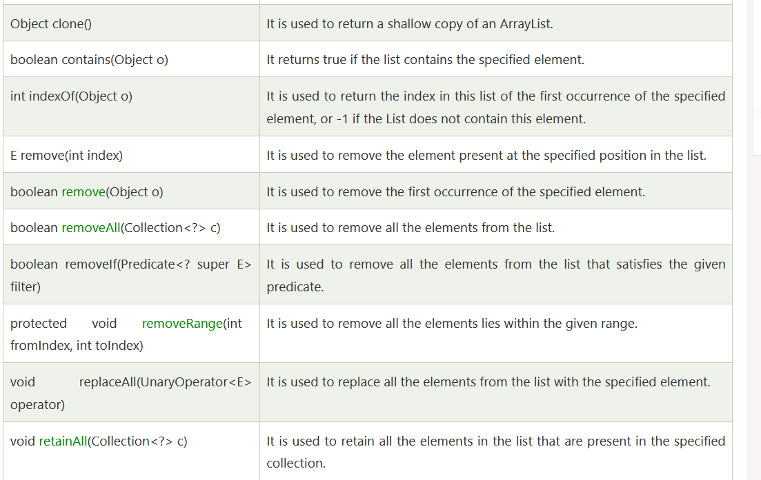
Array List Methods

Slide 75
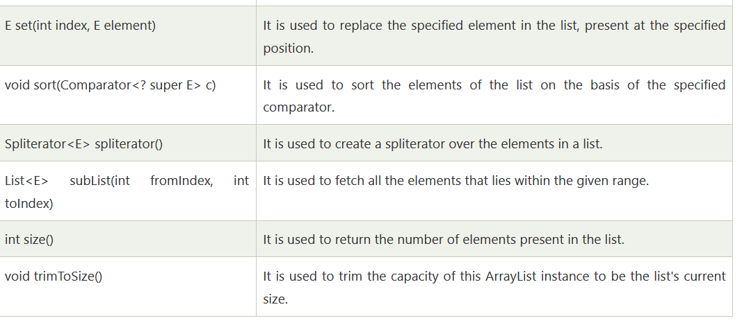
Array List Methods

Slide 76
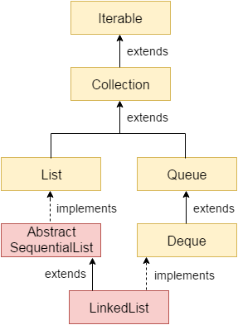
Java LinkedList class uses a doubly linked list to store the elements. It provides a linked-list data structure. It inherits the AbstractList class and implements List and Deque interfaces.
The important points about Java LinkedList are:
Java LinkedList class can contain duplicate
elements.
Java LinkedList class maintains insertion order.
Java LinkedList class is non synchronized.
In Java LinkedList class, manipulation is fast because no shifting needs to occur.
Java LinkedList class can be used as a list,
stack or queue.
Linked List

Slide 77
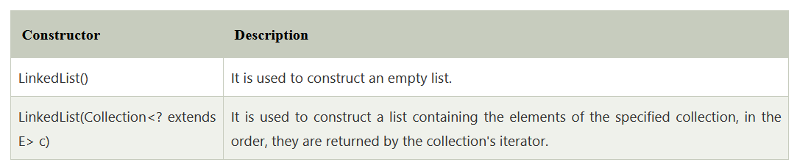
Linked List Class Declaration:
the declaration for java.util.LinkedList class.
public class LinkedList<E> extends AbstractSequentialList<E> implements List<E>, Deque<E>, Cloneable, Serializable
Linked List Constructors
Constructors of Java LinkedList

Slide 78
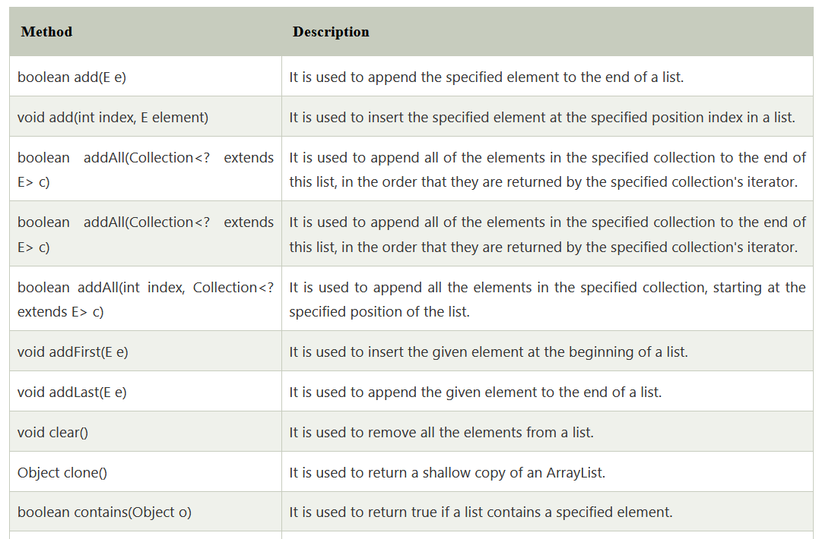
Linked List Methods

Slide 79
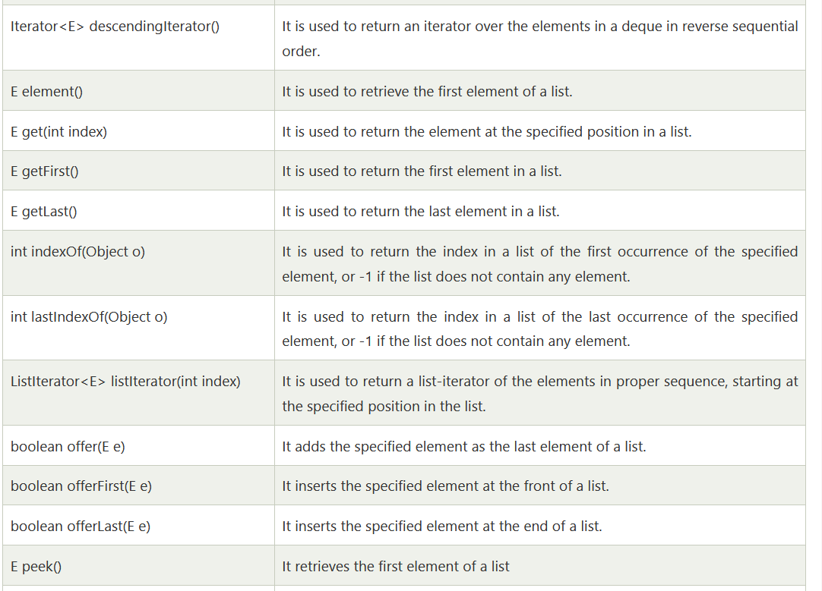
Linked List Methods

Slide 80
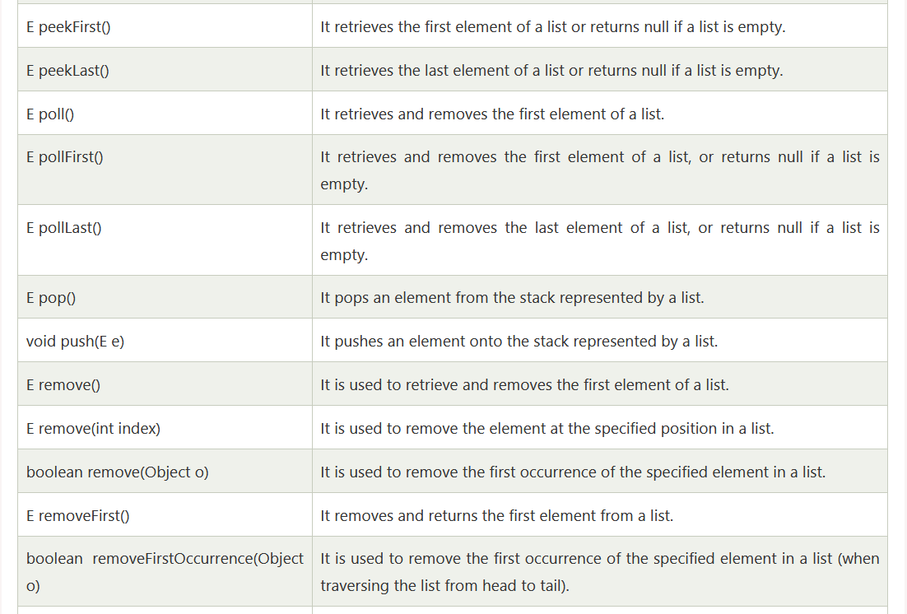
Linked List Methods

Slide 81
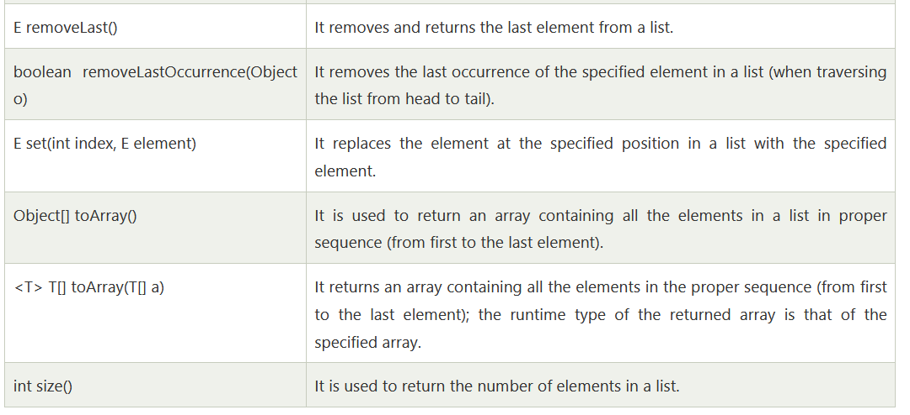
Linked List Methods
Check Programs: LinkedListAddDemo.java, LinkedListRemoveDemo.java, LinkedListSortingDemo.java

Slide 82
A Java Cursor is an Iterator, which is used to iterate or traverse or retrieve a Collection or Stream object’s elements one by one. There are three cursors in Java.
Iterator
Enumeration
ListIterator
Enumeration Iterative Statements
Enumeration is It is an interface used to get elements of legacy collections(Vector, Hashtable). Enumeration is the first iterator present from JDK 1.0, rests are included in JDK 1.2 with more functionality.
Enumerations are also used to specify the input streams to a SequenceInputStream. We can create an Enumeration object by calling elements() method of vector class on any vector object .
// Here "v" is an Vector class object. e is of
// type Enumeration interface and refers to "v"
Enumeration e = v.elements();

Slide 83
here are two methods in the Enumeration interface namely :
1. public boolean hasMoreElements(): This method tests if this enumeration contains more elements or not.
2. public Object nextElement(): This method returns the next element of this enumeration. It throws NoSuchElementException if no more element is present.
Enumeration Iterative Methods

Slide 84
Vector is like the dynamic array which can grow or shrink its size. Unlike array, we can store n-number of elements in it as there is no size limit. It is a part of Java Collection framework since Java 1.2. It is found in the java.util package and implements the List interface, so we can use all the methods of List interface here.
It is recommended to use the Vector class in the thread-safe implementation only. If you don't need to use the thread-safe implementation, you should use the ArrayList, the ArrayList will perform better in such case.
Vector Class

Slide 85
It is similar to the ArrayList, but with two differences-
Vector is synchronized.
Java Vector contains many legacy methods that are not the part of a collections framework.
Vector Class
Java Vector class Declaration
public class Vector<E>
extends Object<E>
implements List<E>, Cloneable, Serializable

Slide 86
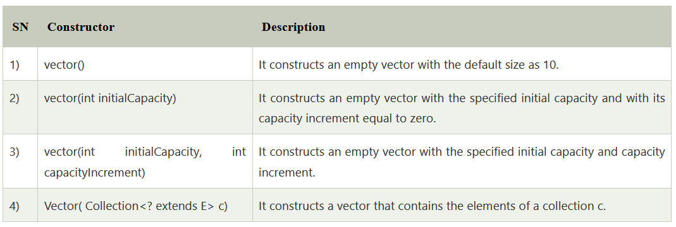
Vector Class Constructor

Slide 87
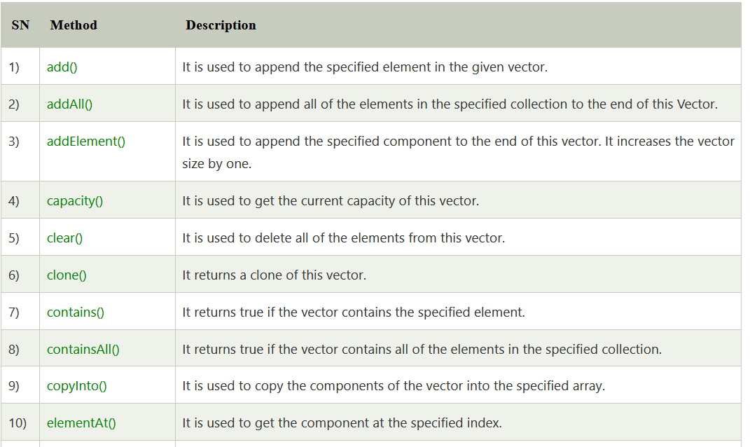
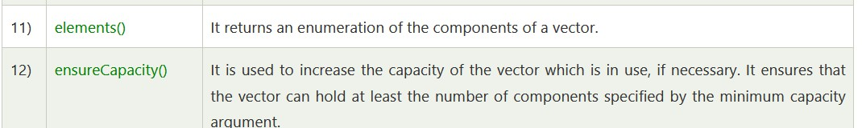
Vector Class Methods

Slide 88
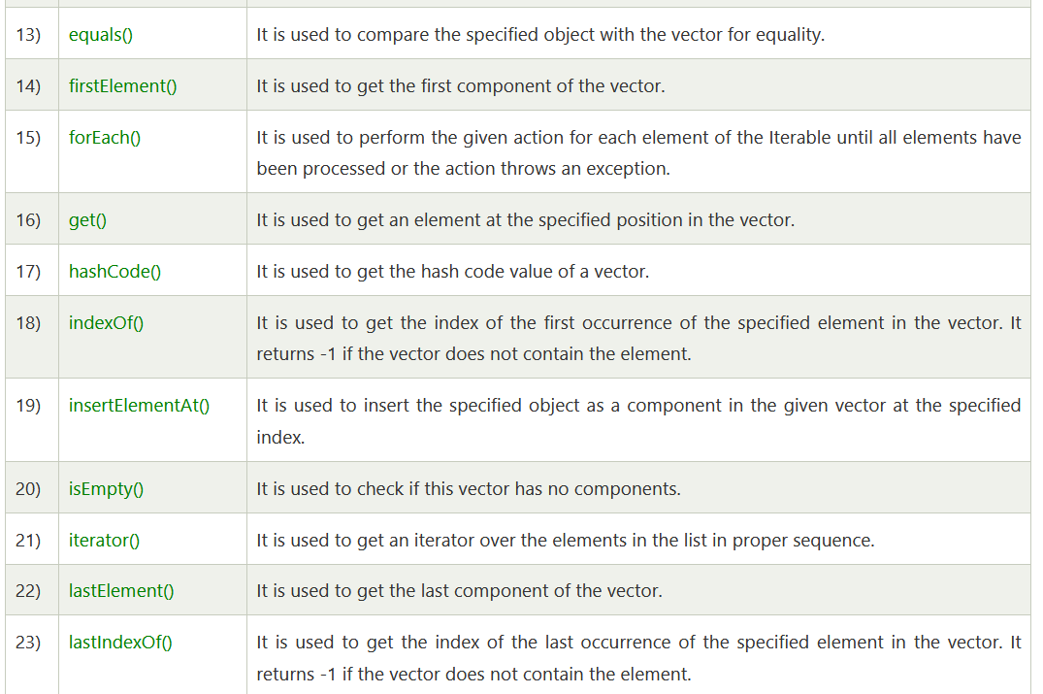
Vector Class Methods

Slide 89
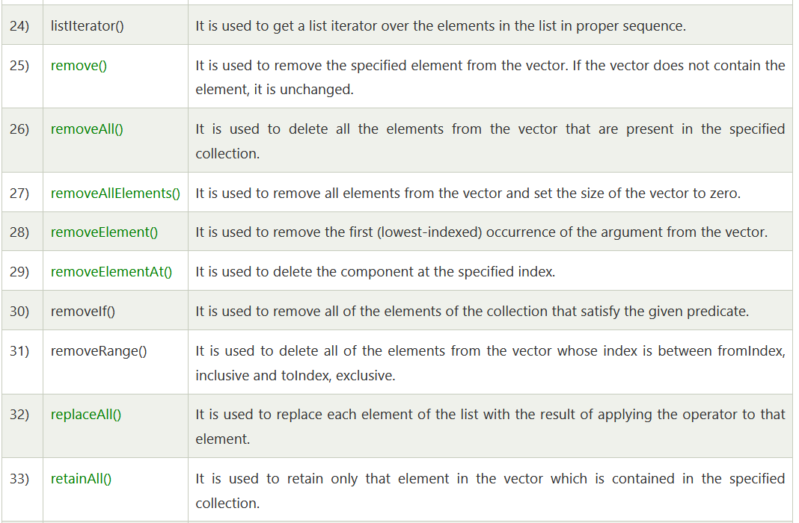
Vector Class Methods

Slide 90
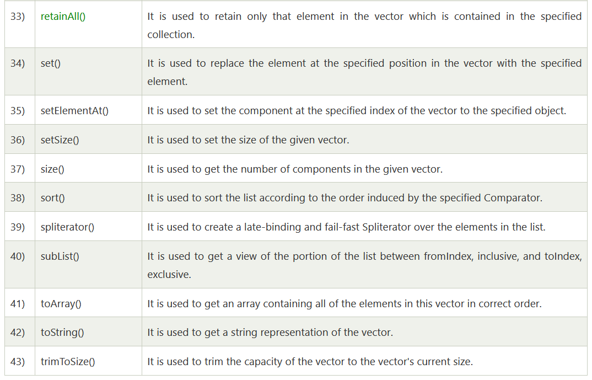
Vector Class Methods

Slide 91
Thank you

